Slide 1
Culturally Responsive STEAM Programming: Engaging Latinx Communities in Rural Areas
Tuesday, September 15th
The webinar will begin at 2:30 pm MT and will be recorded
While you’re waiting:
Find the toolbar – it will either be on the bottom or top of your Zoom window
Introduce yourself in the chat box (please select “All Panelists and Attendees” not “All Panelists”)
Click audio “Join by Computer” – you won’t have microphone access
Tip for viewing: You can resize and move the location of the video and slide screens by clicking and dragging them

Slide 2
Expectations / Guidelines
Try to use the Q&A feature for questions
When using Chat, make sure your messages are being sent to “All Panelists and Attendees”
We are all working from home: tech problems may happen!

Slide 3
Facilitator Introductions
Claire Ratcliffe (Space Science Institute)
BeeBee Browne (American Library Association)
Keliann LaConte (Space Science Institute)
Veronica Casanova (Tulare County Library)
Flo Trujillo (REFORMA de Nuevo Mexico)
Miguel Ruiz (Evanston Public Library)

Slide 4
Today’s Agenda
Ice Breaker and Poll Question
STEAM Equity Project Overview
Defining Cultural Responsiveness
Program Examples
Building Relationships
Discussion
Q&A

Slide 5
What is the strangest place you’ve worked remotely from?
Ice Breaker

Slide 6
Poll Question
What features have you used to make virtual programs more engaging?
Poll Questions
Annotating tools
Breakout Rooms
IdeaBoardz
Word Clouds
Other

Slide 7
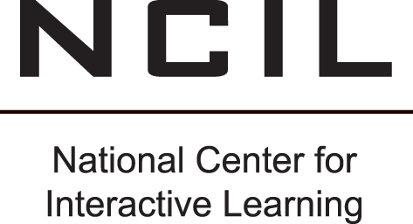
STEAM Equity Project

Slide 8
Interests
Strengths

Slide 9
Empower tweens and their families around equitable STEAM learning and career paths
Notes:
empower tweens and their families around equitable STEAM learning and career paths by leveraging their existing strengths, interests, and diverse cultures.

Slide 10
Collaborate and co-create with Latino* populations
*The project team uses the term “Latino” but acknowledges that communities and individuals may identify as Latino/a/x, Hispanic, Chicano/a, or a variety of other terms.

Slide 11
Advancing Informal STEM Learning
This material is based upon work supported by the National Science Foundation under Grant No. DRL-1906172.
Any opinions, findings, and conclusions or recommendations expressed in this material are those of the author(s) and do not necessarily reflect the views of the National Science Foundation.
Notes:
broaden access to STEM learning experiences

Slide 12
Share what we are discovering about STEAM learning and community collaboration

Slide 13
Learn how library workers can more effectively support tween interest and persistence in STEAM learning in their rural communities.

Slide 14
STEAM Equity Preconference Workshop
Join an annual forum on gender equitable and culturally responsive STEAM learning for:
Networking
Strategies
Resources
Hands-on STEAM activities

Slide 15
Community Dialogues
“Community Dialogues and Libraries,” with Lisa Jackson, Librarian, Supervisor and community members at African American Research Library and Cultural Center (AARLC)
https://stemforall2020.videohall.com/presentations/1653

Slide 16
Cultural Responsiveness -Definitions
Cultural responsiveness is the ability to learn from and relate respectfully with people of your own culture as well as those from other cultures.
Source:National Center for Culturally Responsive Educational Systems (NCCREST)
Notes:
We are going to start this conversation by defining terms. The first term we are going to define is cultural responsiveness.
Cultural responsiveness is a term used in the education field. This definition comes from the National Center for Culturally Responsive Educational Systems They define cultural responsiveness as “the ability to learn from & relate respectfully with people of your own culture as well as you other cultures.”

Slide 17
Cultural Responsiveness - Definitions
the ability to recognize the significance of culture in one’s own life and in the lives of others; and to come to know and respect diverse cultural backgrounds and characteristics through interaction with individuals from diverse linguistic, cultural, and socioeconomic groups; and to fully integrate the culture of diverse groups into services, work, and institutions in order to enhance the lives of those being served by the library profession and those engaged in service.
Source: Cultural competence: A conceptual framework for library and information science professionals by Overall
Notes:
Like I mentioned, cultural responsiveness is a term used in the education field. A term that was used beforehand was “cultural competence.” I want to take a moment to differentiate between cultural competence and cultural responsiveness. At its core, cultural responsiveness and cultural competence mean the same as they both seek to understand, learn & relate in a respectful manner to people of different cultures & your own, but we have to acknowledge that the differences lie within the word “competence” and “responsiveness”. Competency typically refers to an individual reaching a state of proficiency and having the option to stop when it has been achieved. Whereas “responsiveness” means that we are always learning and adapting our points of views, because culture is forever changing and we, as librarians, have to continue to change with it for our library, program and patrons.
The reason I delve into differentiating between cultural competency and cultural responsiveness is because there is an older research article named “Cultural Competence: A Conceptual Framework for library and information science professionals by Patricia Montiel Overall. While it is an older article and it does use the term cultural competency, the definition can be used to describe cultural responsiveness. The definition is as follows “the ability to recognize the significance of culture in one’s own life and in the lives of others; and to come to know and respect diverse cultural backgrounds and characteristics through interaction with individuals from diverse linguistic, cultural, and socioeconomic groups; and to fully integrate the culture of diverse groups into services, work, and institutions in order to enhance the lives of those being served by the library profession and those engaged in service”
This is a great definition and I want to also add that this is a circular process. The next slide will give a visual of this process.

Slide 18
Cultural & Personal Experiences
Interactions with patrons
Professional Development
Cultural Responsiveness
Cultural Reflections of Other’s Cultures
Education
Cultural Self-Reflection
Reading
Travel
Notes:
For those of us that are visual learners, I put together a graphic which notes different areas that influence and change our culture responsiveness. Please note that the directions of the arrows as cultural responsiveness is affected by these factors. I also want to point out that it is a circular or continually process that keeps evolving.

Slide 19
What is Cultural Responsiveness to you?
Type in the chat box the answer to the question
Notes:
Okay, so we have discussed two definitions of cultural responsiveness. I want to know with these definitions in mind, “What does cultural responsiveness mean to you?” Please type in the chat box.

Slide 20
Why is Cultural Responsiveness important?
-Patrons feel like they are respected and viewed as an important part of the library/community.
-Culturally Responsive library staff know how to integrate social, cultural, and linguistic information in a culturally sensitive manner
-Avoids tokenism for the program and program reflects a cultural authentic program

Slide 21
Latino/Latina - Definition
-Latino/ Latina - Descendent, or person of, Latin America
-The Spanish language leaves room for only the masculine term (Latino) or the feminine term (Latina).
Notes:
We have defined cultural responsiveness, but we also want to define the term “Latinx”. Before we define “Latinx”, we want to talk about what is a Latino or Latina. A Latino and/or Latina is a person of Latin American descendent, such as people of Mexico, Latin America, and the Caribbean Islands. Please note that the Spanish language leave room only for the masculine term “Latino” ending with an “o” and “Latina” the feminine term ending with the letter “a”.

Slide 22
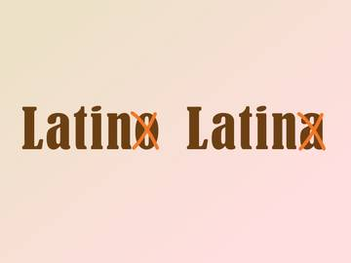
Latinx - Definition
-Latinx = Latin + x
-Latin = Descendants (or people of) Latin America
- X = gender neutral term, designed to be inclusive to all female, male, trans, queer, and/or non-binary
-The term “Latinx” is gaining popularity as a recent Pew study demonstrates that 3% use the term.
Source: Merriam Webster
Notes:
Knowing that the language only leaves room to define males with Latino, or females with Latina, the term does not allow room for our nonbinary, queer or trans communities. Keeping other in mind, the term “Latinx” was created. The “X” in Latinx is a gender neutral term to include our friends from other genders. The term is gaining popularity as a recent Pew study demonstrates that 3% use it. Now that we have defined cultural responsiveness, highlighted its importance & defined Latinx. It is through this lens that we ask you to view the presentation and I will hand it over to Flo.

Slide 23
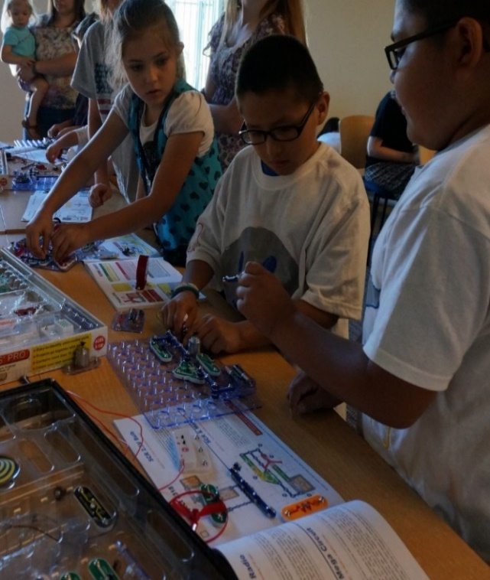
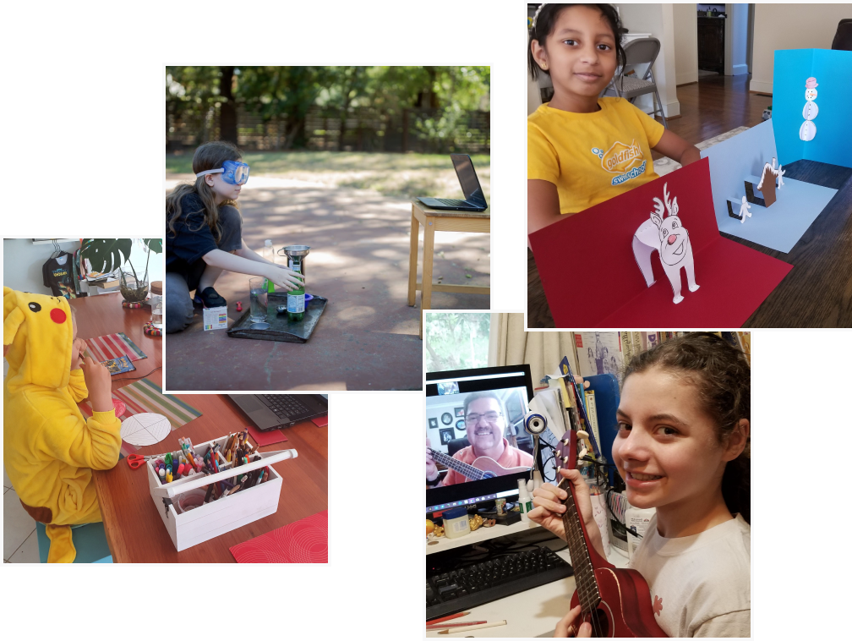
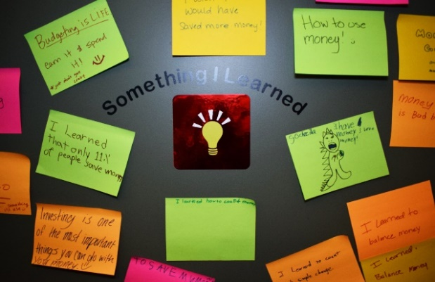
Culturally Responsive Program
What does it look like… will it be virtual?
Welcome families
Introduction – Chat Rooms - Something they learned
Ground rules, facilitator, breakaway room
ZOOM or Google Meet platforms
Some common misconceptions
Notes:
Culturally Responsive Program – What does it look like… will it be virtual?
An in-person session is preferred, but during COVID, it can be a great opportunity to work with families to help their kids learn in the virtual world.
Introduction – Chat Rooms – Something they learned
Welcome and introduce yourself to the families as they arrive for the in-library program. You may notice if there is any language barriers. Make sure to sign in for the session. Have families design a nametag with their first name, and, if you are using a translation device, translators may need to explain to families how to use the device. If this is a virtual event, open the session no later than 15 minutes for families to arrive on screen. To make families feel comfortable, you may need to share how to change the name on the screen, type in the chat room, explain the speaker view screen, and how to use the mute button.
Start on time and have staff introduce their roles for the virtual session. Begin with an icebreaker to invite families to introduce themselves, but you may need to call of them. Consider using a talking stick to ensure an equal voice and respectful communication. For a virtual presentation, ask the participant to pick up a pen, or item they can use to pass it along to a person they see on the virtual screen.
Before families leave the virtual session, have them share in the chat box, “something they learned.” If you have an in-library session, ask families to write on a post-it and put them on the wall.
Ground rules – facilitator, breakaway room
After introductions, set ground rules, for a virtual program request the mute button is off, unless they are going to talk. Families may arrive late, but try to engage them in conversation whenever possible during the program. If you are doing an in-library program, you may need to create a breakaway space and activity for kids under the age of 6.
Designate a staff to help facilitate during the virtual session, they can let families into the virtual room and can update the facilitator with questions in the chat room.
ZOOM or Google Meet platforms –
During in-library or a virtual session, keep the conversation and activity going with open-ended questions. You may want to use all of the bells and whistles the virtual platform provides, but space it out, to make it a learning activity. In-person is much easier since you will have hands-on science centers.
Some Common Misconceptions
Latinx families all speak fluent Spanish and poor broken English. All Latinx families are recent immigrants. All Latinx physical characteristics are the same. All Latinos celebrate the same traditions, customs and eat the same food. All Latinx parents have the same educational level.
Latinx Family Engagement is about becoming culturally competent to the community you are serving by truly understanding the family’s primary needs and wishes, forming a strong rapport with community partners, and creating a safe and informational library hub for all Latinx families.

Slide 24
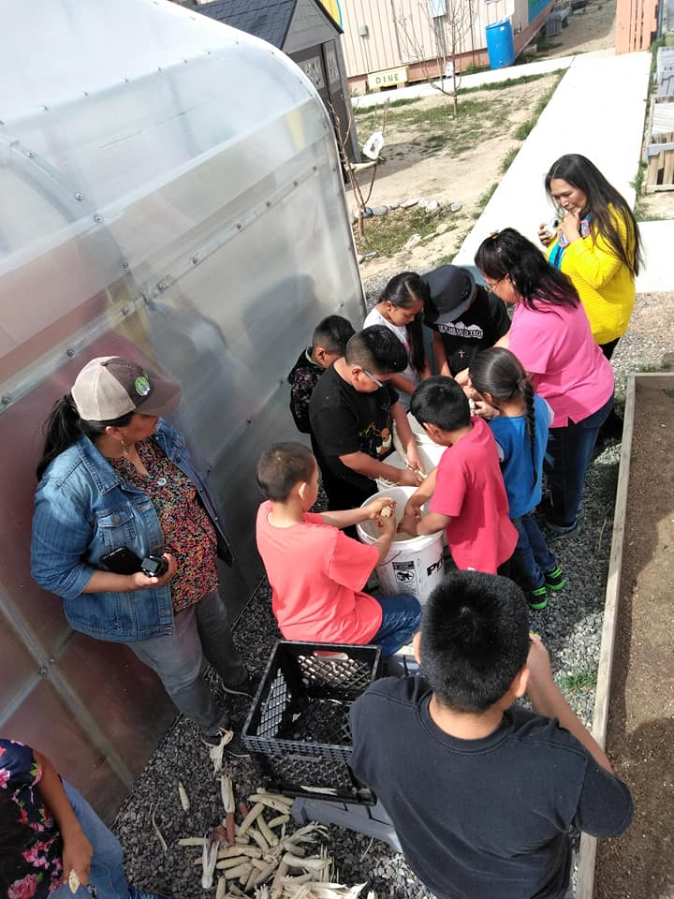
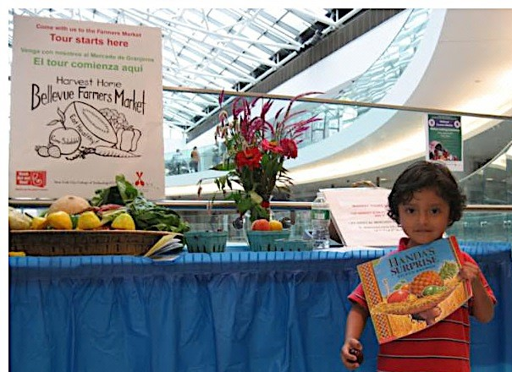
Culturally Responsive Program
Identify STEAM in the community
Virtual Technology in Rural and Urban Communities
Food Security /Gardening
Health Professionals
Notes:
Identify STEAM in your community
Use time during your session to create a resource commercial.
Share a resource page to link families to Markets, transportation and free breakfast and lunch programs. Most families have visited a Farmer’s Market at least once and may have used WIC Farmers Market Coupons.
Food Security/Gardening
Do you know how to cook a hotdog using solar energy? How can you use origami to start a garden?
Invite families to look for local Growers tours, or visit the county fair, there is a lot of STEAM opportunities. Remind families to check out books on STEAM. Schedule a cooking or recipe sharing virtual event. Recently, teen Latinas presented a virtual ZOOM event to senior citizens on how to make traditional “Mexican Melon Smoothie” and shared other fruits they could use for the refreshing summer drink.
Health Professionals
Athletes and medical professionals can share nutrition and exercise opportunities and STEAM careers. Local colleges have medical students who need to do work study or service hours and are looking for opportunities to share. Don’t forget about Scientists and Astronauts and the local herbalist!
Virtual Technology in Rural and Urban Communities
Rural and Urban communities both rely on libraries, community centers, coffee shops, etc. for free Wifi. But schools are working to make sure all children have a laptop and access to the internet for virtual lessons. Unfortunately, not everyone can afford a new computer and the school laptops are limited to the lesson platforms, and research is limited.

Slide 25
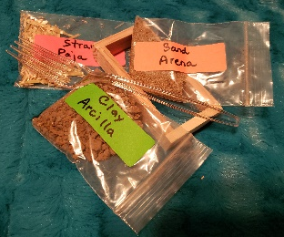
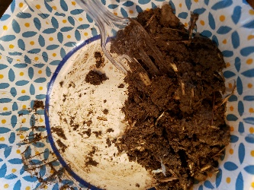
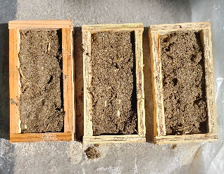
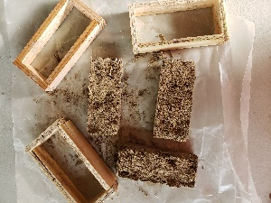
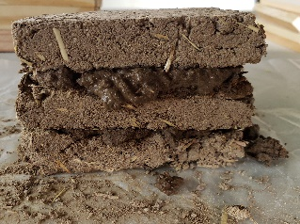
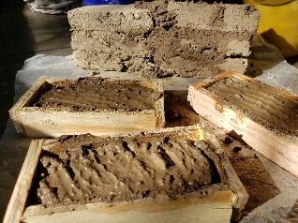
STEAM Adobe
https://reformanm.blogspot.com/
Request a kit for STEAM Adobe
Notes:
Request a kit from REFORMA de Nuevo Mexico to re-use and make a hacienda, little casita, ruins or pueblo.
As the oldest granddaughter, I enjoyed making mud pies. My grandfather was a carpenter with eight sons, and as our families grew so did their home. My grandfather kept me busy and had me sieve dirt to make sand and break up straw that we fed to the animals, and throw it into the wheel barrel as he mixed the “mud” solution. He let me pour some of the mud into the squares and he leveled it off and left it to dry. After a few days, the adobe bricks were used to build an extra room.
Please enjoy my cultural experience and my first STEAM Adobe!
--Adobe Bricks weigh about 30-40 pounds.
--Clay acts as a glue, and adding the straw keeps the adobe from cracking and helps it to dry evenly, while the sand strengthens the brick.

Slide 26
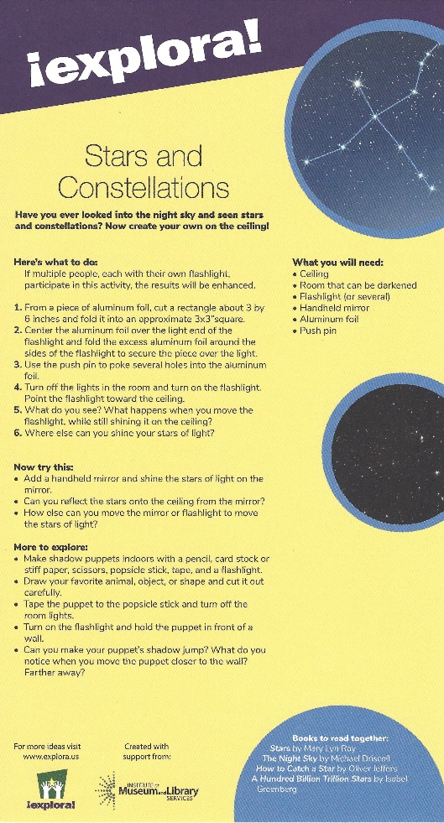
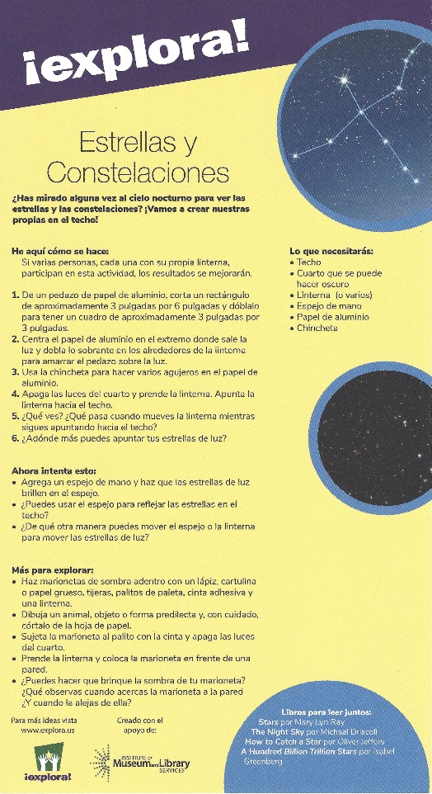
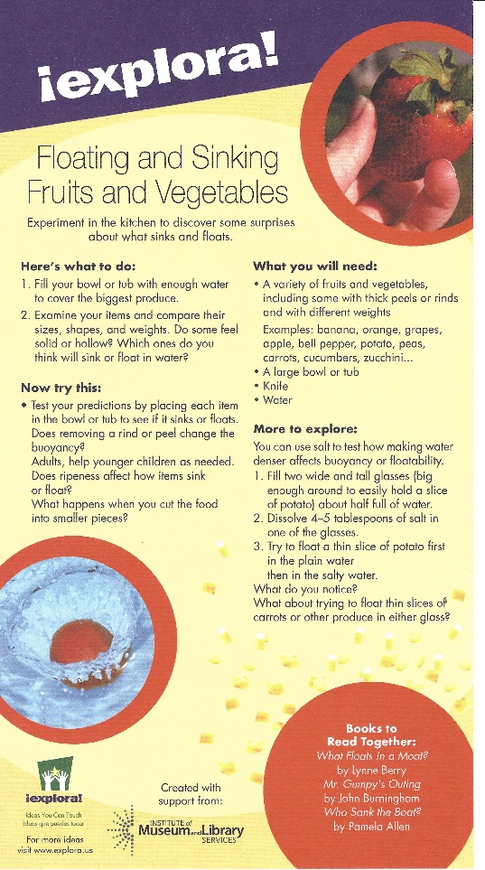
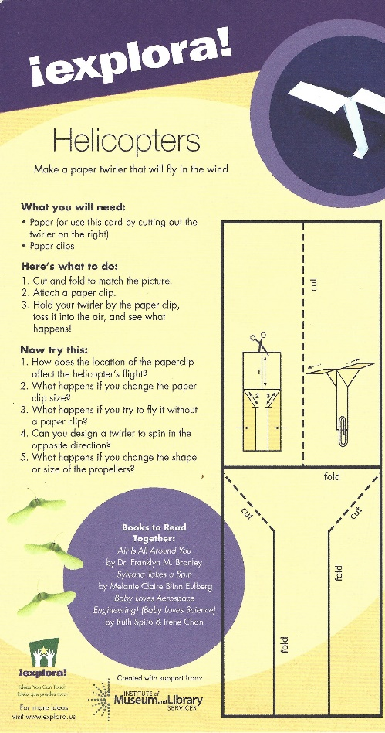
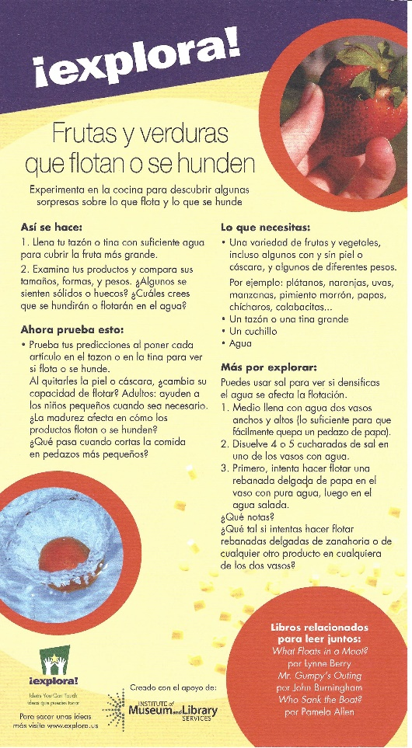
https://www.explora.us/
Notes:
Living in New Mexico, I am very familiar with Explora, a great education center that offers interactive experiences in STEAM.
EXPLORA bilingual activity cards explain a simple experiment, the science behind it and how it is relevant to people’s lives, including the career fields that work in the area. The cards offer a STEAM booklist you can read together.

Slide 27
>Building Relationships
Identify existing relationships
Research community groups
Connect to organizations/institutions
Connect with community leaders
Connect with families/individuals

Slide 28
>>How to Connect
Leverage existing partners
Pick up the phone
Type a personal email
Attend (virtual) events
Attend real (socially distanced) events

Slide 29
>>>What not to Say
Actively listen…actively
(Internally) connect aspirations with library resources
Don’t laundry list resources
Be OK with no tangible next steps
Networking as a leadership habit

Slide 30
>>>>What to Say
Ask about issues, barriers, challenges
Ask about current events, programs, services
Ask about goals for youth and families
Discuss opportunities for collaboration

Slide 31
>>>>>Follow-up
Not all conversations lead to partnerships
Conduct cultural research
Identify tools needed to collaborate
Translations, day-care, bilingual support, trusted 3rd party
Contact experts

Slide 32
>>>>>>Lead a community dialogue
Leverage your existing and new partners
Explain and send questions
Make room for 1:1 and group conversations
Identify translators (host in native language)
Follow-up with leaders on next steps!

Slide 34
Thank you!
Any Questions?

Slide 35
Discussion
What is one thing that doesn’t cost any money that your library could do now to start implementing culturally responsive programs?

Slide 36
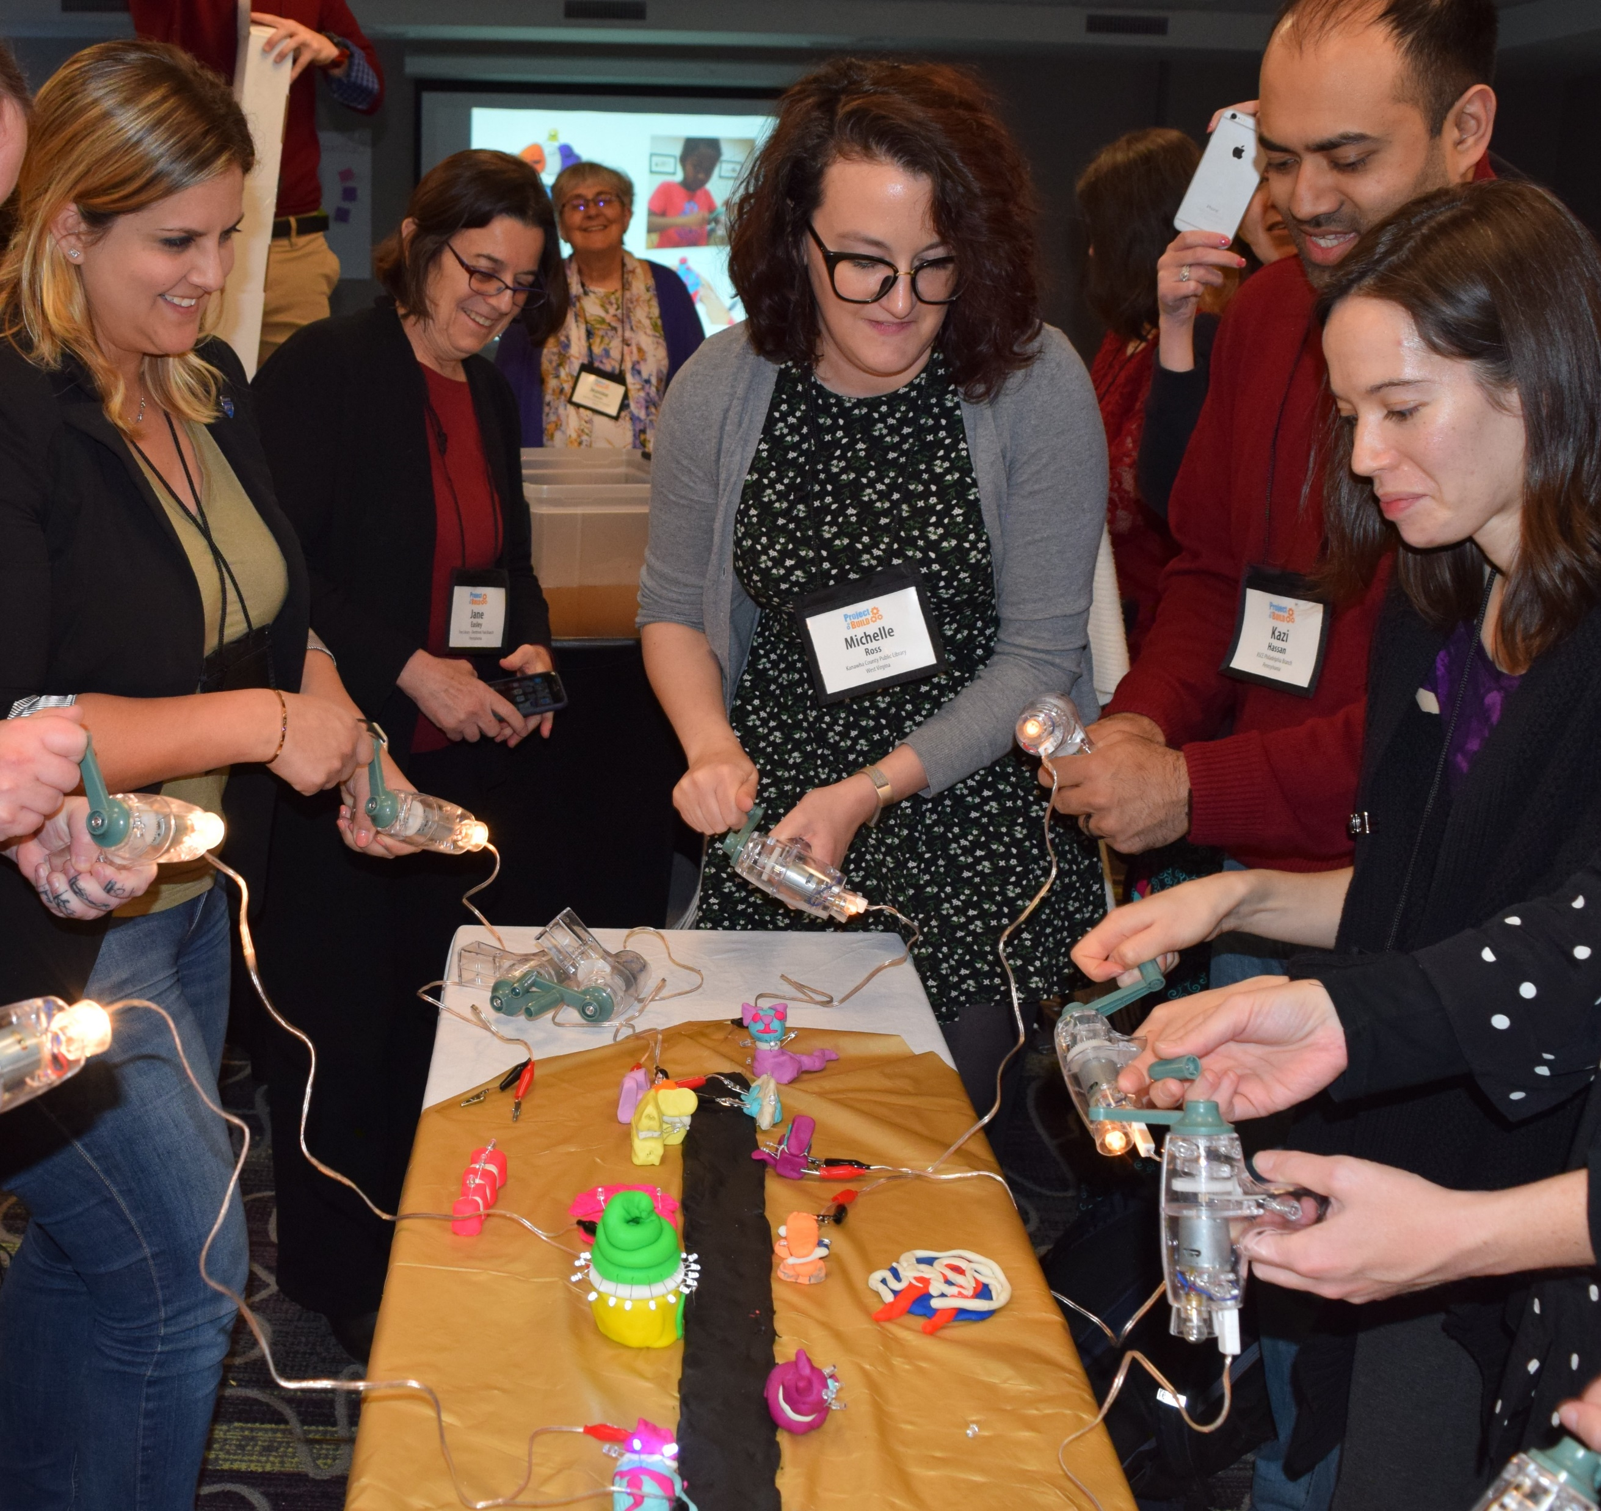
FREE
Science-Technology Activities & Resources
www.starnetlibraries.org
Notes:
The Space Science Institute’s National Center for Interactive Learning provides free hands-on activities, resources, and training to library professionals through its Science‐Technology Activities and Resources Library Network (STAR Net). Core partners include the American Library Association (ALA), Urban Libraries Council, Cornerstones of Science, American Society of Civil Engineers, and many other organizations.

Slide 37
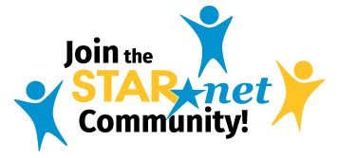
@STARNet_Project
#STEMinLib
/starnetlibraries
/STARLibraries
/Star_net
www.starnetlibraries.org
Notes:
Energy, tips from 8,500 members

