Slide 1
How to Spot Fake News
Diana Laughlin
Program Services Supervisor, Estes Valley Library
Notes:
Welcome!
I’m Diana Laughlin, on the Program Team at Estes Valley Library.
This morning, we’ll practice our news literacy skills.
I’m going to give you some challenges during the class to check your ability to spot fake news. It’s harder than you think!
I want to acknowledge that this is a politically charged topic. The library’s goal is to offer an opportunity for education and civil dialog. We all know that there are a variety of viewpoints in the room, and that’s a good thing. So, while we may not all share the same opinions, we can all agree to be respectful of different viewpoints.
Use Slido.com, or other polling tool, to ask:
What concerns you about fake news? (select all that apply)
News outlets are more biased than balanced
People get tricked by false information
Threat to national security
No one is held accountable for misinformation

Slide 2
News Literacy Skills
Fair & Balanced News
Facebook Shares
Critical Judgement of News Online
Deconstruct the News
Tools & Resources
Notes:
Format:
Present skills for critical judgement of news sources.
Goal = ability to identify fake news.
Show some videos, discuss with person next to you, play Fake News game, resources on Library website.

Slide 3
What is News Literacy?
The ability to use critical thinking skills to judge the reliability and credibility of news reports whether they come via print, television, or the internet.
Notes:
We’ll practice evaluating the news from all 3 sources during today’s class: print, television, and internet.

Slide 4
DIY News
Notes:
More often now, citizens are the sources of news (i.e. cell phone video at a protest) and producers of news (anyone can create a website, write blog article, post video on YouTube)
= empowers us as citizens to report local, emotional events which might be overlooked or misrepresented by legacy news outlets. The news we view is longer limited by the “gatekeepers” of a small group of outlets: CBS was 1st, then ABC, NBC...Fox, CNN...
= not in context, not fact-checked by a news team or newsroom editor, not vetted, information overload, can’t accept at face-value must research outlet and compare to 3 others. Just because it’s a good looking website, doesn’t mean it’s true.
New Media = blurred lines between news, opinion, advertising, satire, entertainment

Slide 5
Why is News Literacy important?
62% of U.S. adults get news on social media
88% of U.S. young people get news from Facebook or other social media site
Pew Research Center “News Across Social Media Platforms”
Notes:
News Literacy is important because:
People can’t tell the difference between ads, articles, opinions, entertainment, and news and many don’t care.

Slide 6
“Seek truth and report it.”
Society of Professional Journalists
Code of Ethics
Notes:
Journalists always seek the truth
The problem is that today a story looks like news from a journalist, but it is really an ad, opinion, or entertainment. The writer is not following this ethic, but people assume that they are.

Slide 7
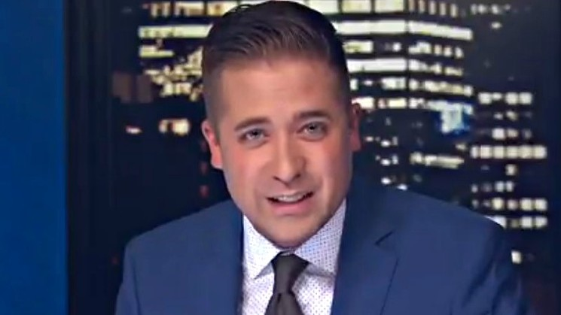
Investigative journalism seeks truth in the data
https://www.9news.com/video/entertainment/television/programs/next-with-kyle-clark/commentary-no-there-havent-been-18-school-shootings/73-8011325
Notes:
Here is an example of a Denver journalist pursuing truth in a very difficult topic: school shootings. February 2018 after Florida shooting.
Kyle Clark with Channel 9 News Denver
Investigative journalism to seek the truth in data
News reports what will gain viewers, such as “18 school shootings.” They don’t have time to fact check it, because if 1 outlet runs the story, they all have to run it. Kyle Clark is the only one who took the time to seek the truth and report it accurately.

Slide 8
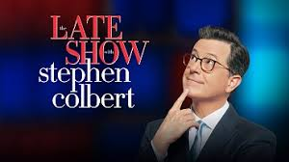
“Truthiness”
Something must be true, because I believe it to be true.
Stephen Colbert
Notes:
No video with this slide
The truth is under attack: Photoshopped photos are fake. Dubbing incorrect audio on videos. We can’t even believe what we see.
People post photoshopped tweets to misrepresent other’s statements.
Raise your hand - who could create a fake Tweet? How long would it take you?
Raise your hand - who could spot a fake Tweet?
I could produce a photoshopped Tweet in 30 minutes. I wouldn’t be able to tell the difference if someone else did it.
Stephen Colbert: “Truthiness = Something must be true because I believe it to be true.”
Journalists and scientists do not believe in absolute truth. What we call “truth” changes as evidence accumulates.
“Truth” can change and new evidence reveals new insights.
Classic example = Pluto
Raise your hand - is Pluto a planet?
Raise your hand - is Pluto not a planet?
The facts change, as we get more information.

Slide 9
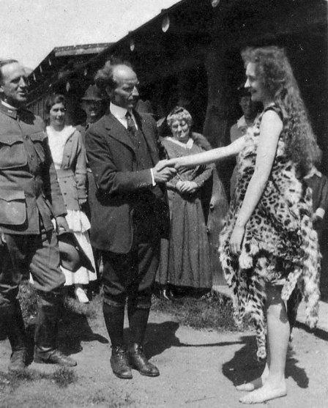
The “Eve of Estes”
a 1917 publicity hoax by the Denver Post and Rocky Mountain National Park
Notes:
We have an example of a journalist not reporting the truth from the history of Estes Park.
“Eve of Estes”
A publicity hoax by the Denver Post and RMNP described in book America’s Switzerland by Estes Park Historian, Dr. James Pickering

Slide 10
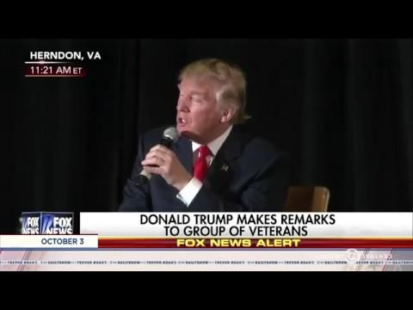
Notes:
This video is attached as a separate file
Are the facts cherry picked to misrepresent information?
Trevor Noah Daily Show during 2016 presidential campaign
Points out misrepresentation of media on both sides of political spectrum
We realize as a source the Daily Show is left of center. And host takes a couple of jabs at President Trump. Great example of the media cherry-picking evidence rather than presenting complete facts in context.
Examples of hearing a headline and not reading the complete article. Media is guilty of this as much as individuals.

Slide 11
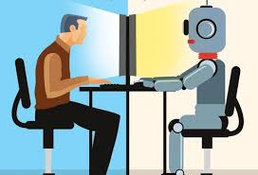
Bots and Trolls in elections
https://www.cbc.ca/player/play/1347148355910
Notes:
Speaking of elections, you might recall hearing that Russia potentially manipulated the 2016 Presidential election. Here’s what happened.
Add explanation of bots in 2016 presidential election and 2018 mid-terms from Canadian Broadcasting Corporation scroll down for 6 minute video
Let’s remember this in the 2020 election. Who can vote in November?

Slide 12
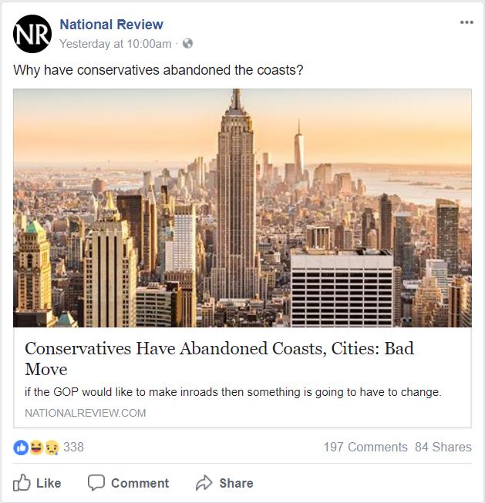
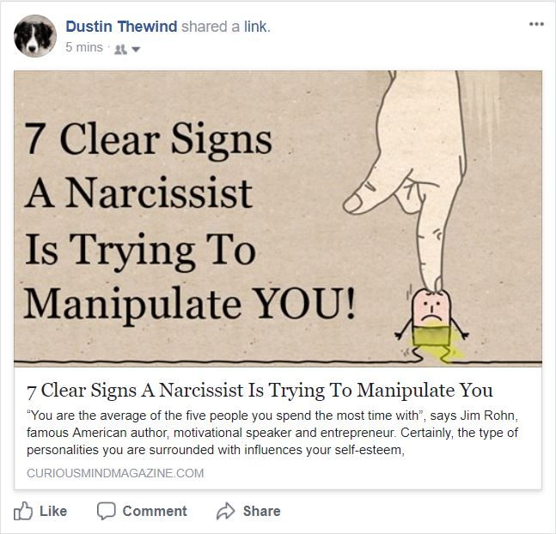
Notes:
Facebook article comparison
What can you tell me about how these two posts are similar and different?
Talk to the person next to you for 5 mins, then we’ll share out to the group.
Both have good pictures and clear text
Opinion piece directly from a reputable conservative news outlet. This content exists because the news outlet writes articles. On my feed because I liked the news outlet.
Quasi social science article from an unreliable source for entertainment. This content exists because clicks = ad revenue. On my feed because a friend shared it.
Curiousmindmagazine.com
Copyright out of date
About Us = has ads
Contact Us = no contact info = no transparency
If you like these articles, no problem! Feel free to enjoy them. Just take a moment to appreciate that the content is for entertainment. It’s not science and it’s not news.
Which one will people be more likely to click on or share?
Which will people read? Neither 60% share without reading -Columbia University
Columbia University and the French National Institute, 59 percent of links shared on social media have never actually been clicked: In other words, most people appear to retweet news without ever reading it.

Slide 13
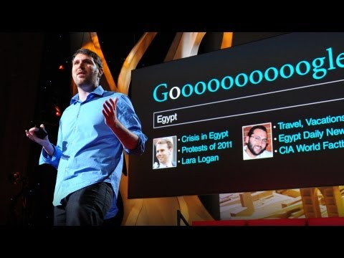
The danger of filter bubbles
https://youtu.be/4w48Ip-KPRs
Notes:
The danger of filter bubbles on Google searches and Facebook feed
Takeaway = go out of your way to consume a wide variety of viewpoints of the news. Read across the aisle and check international news
Stop video at 4 mins
Concern is the internet as presented to me is not unbiased. It’s my bias. I have to go out of my way to find information that doesn’t agree with my bias.
Check 3 news outlets. Intentionally check outlets that lean to other side of political spectrum.
Pass out the Media Bias Chart - this is a tool to seek out balanced, high quality information.

Slide 14
Factitious:
A game that tests your news sense
factitious.augamestudio.com
Notes:
I demo first round, then audience can play a few rounds on their own or with a friend

Slide 15
Deconstruct the News
Is it news, advertising, entertainment?
What is the quality of evidence?
What sources are used?
Is the story fair?
What information is missing?
Notes:
Denver International Airport conspiracies- compare 2 videos, talk with partner
Is it news, advertising, or entertainment? “Journalism is defined as a process of verification that aims to confirm or establish facts.”
What is the quality of the evidence?
What sources are used?
Is the story fair?
What information is missing?
What is the outlet? Do we know if it’s reputable?
BuzzFeed- “An employee reported,” “supposedly,” DIA volunteer, stock photos. Indirect evidence, anecdotal evidence. “These are facts”
Channel 9 News- direct evidence
Raise your hand: which video do you think has more views?
Channel 9 News 3,000 views
BuzzFeed has 2 million views

Slide 16
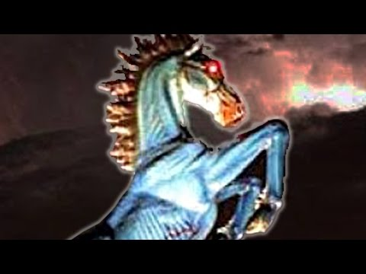
https://youtu.be/NN8DO-Xv9wA

Slide 17
https://youtu.be/XYoNjGcT-4Q

Slide 18
Tools & Resources
America’s News
Library catalog news search
“Read Across the Aisle” app
Notes:
Conclusion:
How do we apply these critical judgement skills to our news consumption going forward?
It could be fake.
The news could have gotten it wrong.
Research by checking multiple outlets. Read across the aisle.
Pay for your news- support good journalism
Facebook news feed “I don’t check the news on FB so I’m not at risk.” Risk of manipulation: filter bubble, algorithm, my friend shares something I like and I read just the headline then share it too
Share only if you read the whole article and checked it against other sources

Slide 19
Questions & Discussion

