Slide 1

Oral History @ Your Library
A Beginner’s Guide

Slide 2
Welcome and Announcements
  Today’s webinar is a presentation of ALA’s Public Programs Office and is part of Latino Americans: 500 Years of History, a programming initiative offered in partnership with the National Endowment for the Humanities (NEH). Learn more at www.ala.org/latinoamericans.
  News from the Public Programs Office: Applications now being accepted for the Great Stories Club and Explore Space, Explore Tech and Explore Earth.
  Tech issues on today’s webinar? Send a private message to Brian Russell.

Slide 3
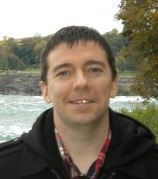
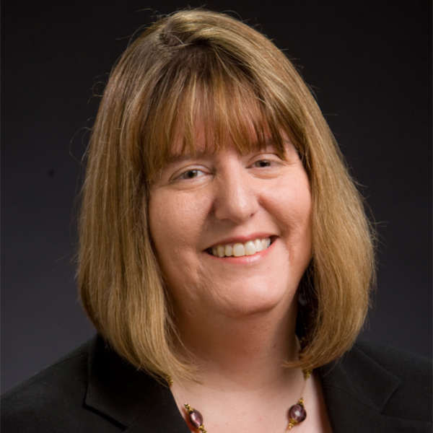
Today’s Presenters
  Mary A. Larson
  Associate Dean for Special Collections Oklahoma State University Library
  Jeff D. Corrigan
  Oral Historian
  The State Historical Society of Missouri

Slide 4
Webinar Agenda
Introduction to Oral History (Jeff)
Programming Ideas (Mary)
Resources (Jeff)
Technology (Mary)

Slide 5
Introduction to Oral History

Slide 6
What is Oral History?
“Simply put, oral history collects memories and personal commentaries of historical significance through recorded interviews.”
  Source: Doing Oral History (3rd Edition)
“Oral History is primary-source material created in an interview setting with a witness to or a participant in an event or a way of life for the purpose of preserving the information and making it available to others. The term refers both to the process and the interview itself.”
  Source: The Oral History Manual (2nd Edition)

Slide 7
How does oral history contribute to our knowledge?
Fill in the blanks
Adds depth to an already well-documented story
Gets the story of both the elite and ordinary
Helps to chronicle underrepresented communities

Slide 8
Some Key Elements of Oral History
Careful attention to copyright and other legal and ethical issues
A controlled, recorded interview setting
Collection of first-hand information
Use of high-quality recording equipment
Adherence to careful processing techniques
Provisions for making interviews available at an accessible repository
Source: The Oral History Manual (2nd Edition)

Slide 9
Key Elements
Careful attention to copyright and other legal and ethical issues.

Slide 10
Key Elements
A controlled, recorded interview setting
  Libraries are GREAT for this!!!
    Quiet rooms that can be reserved
    Accessible

Slide 11
Key Elements
Collection of first-hand information
  “You’re putting people back in the movie of their life” – Jacqui Banaszynski Pulitzer Prize Winning Journalist & University of Missouri Faculty Member

Slide 12
Key Elements
Use of high-quality sound or video equipment
  Consider putting together an oral history field kit that can be checked out!
  Provide access to equipment in-house

Slide 13
Key Elements
Adherence to careful processing techniques

Slide 14
Key Elements
Provisions for making interviews available at an accessible repository
  Libraries are key!
    Local history section
    Special collections
    Archives

Slide 15
Programming Ideas

Slide 16
Identify your goals
Are you trying to educate people?
Are you attempting to build a sense of community?
Are you wanting to fill gaps in your local historical record?
Are you looking for a project for young people?
Are you trying to find a way for older volunteers to contribute to your library?
Are you just looking for a program for that empty slot in September?

Slide 17
Identify your resources
What do you already have in the way of:
Volunteers?
Funds?
Community groups who would be willing to help?
Equipment ?
Your goals and your available resources will likely impact what types of projects you can undertake.

Slide 18
Programming Ideas
Two primary approaches to oral history programming in libraries:
Using existing oral history interviews
Generating new ones

Slide 19
Using existing oral histories
Useful for:
One-shot educational programs on a particular topic (the Dust Bowl, women’s history, local-interest stories)
Supplementary material for book discussion groups
Providing historical perspective on events in your community

Slide 20

Using existing oral histories
Where to find oral history collections:
http://www.oralhistory.org/centers-and-collections/
Also, regional organizations might be able to help you locate material:
http://www.oralhistory.org/regional-and-international-organizations/

Slide 21
Using existing oral histories
If you are using existing oral histories, please be sure to check copyright or use restrictions, as they may limit how you are able to incorporate interviews into your projects or presentations.

Slide 22
Generating new oral histories
Useful for:
Community building
Engaging enthusiastic volunteers
Filling in gaps in community history
Educating people on the process so that they can use oral history in their own projects

Slide 23
Generating new oral histories
There are a number of possible, non-exclusive approaches to this:
Collaborating with an existing oral history program.
Having an oral historian provide training.
Providing equipment for check-out.

Slide 24
Generating new oral histories
Aspects you’ll need to consider:
Equipment for recording and playback
Representative selection of interviewees
Release forms (so that you can make them available at the library)
Processing (so that you can make them discoverable as well as available)
Preservation

Slide 25
Resources

Slide 26
Resources Available
There are so many resources out there!!
Books and other print material
Organizations and institutions

Slide 27
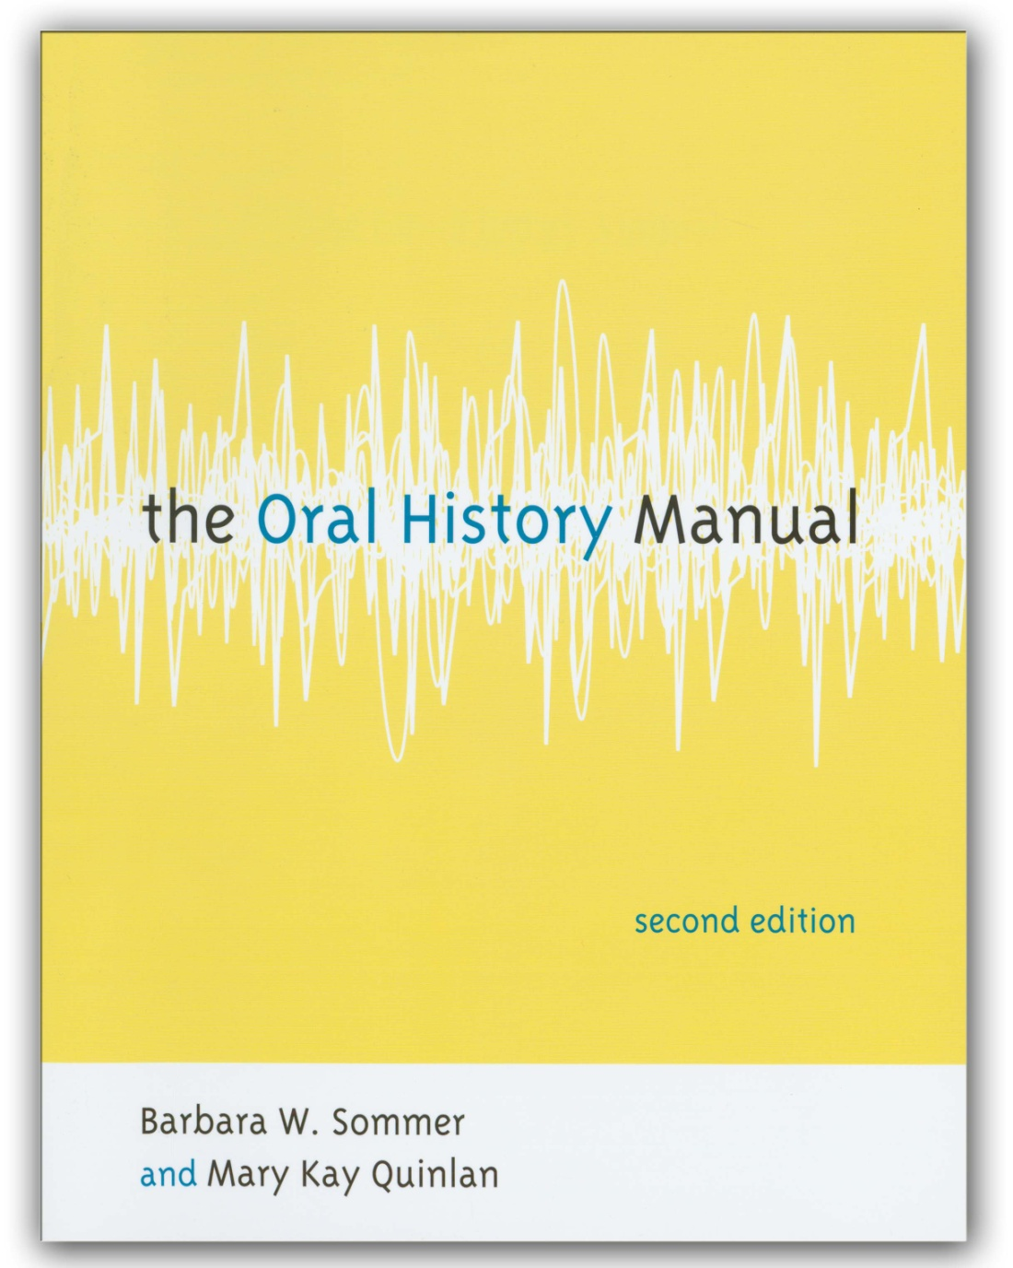
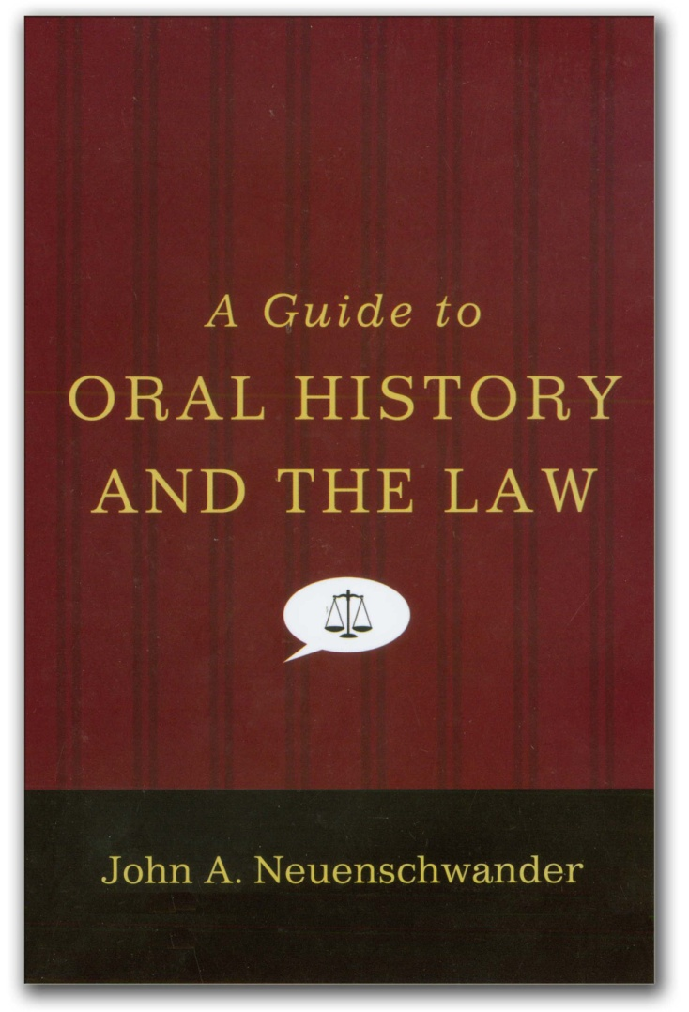

Slide 28
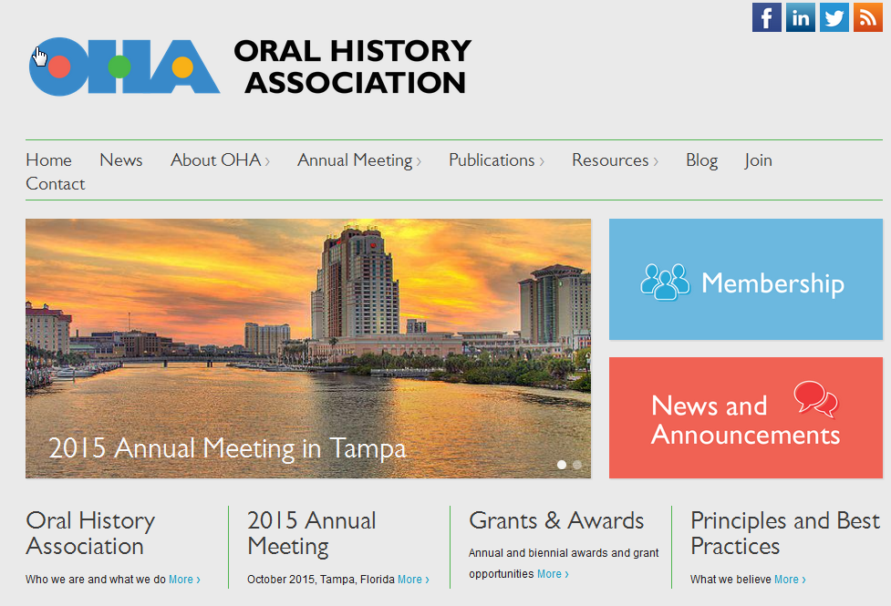
Oral History Association

Slide 29
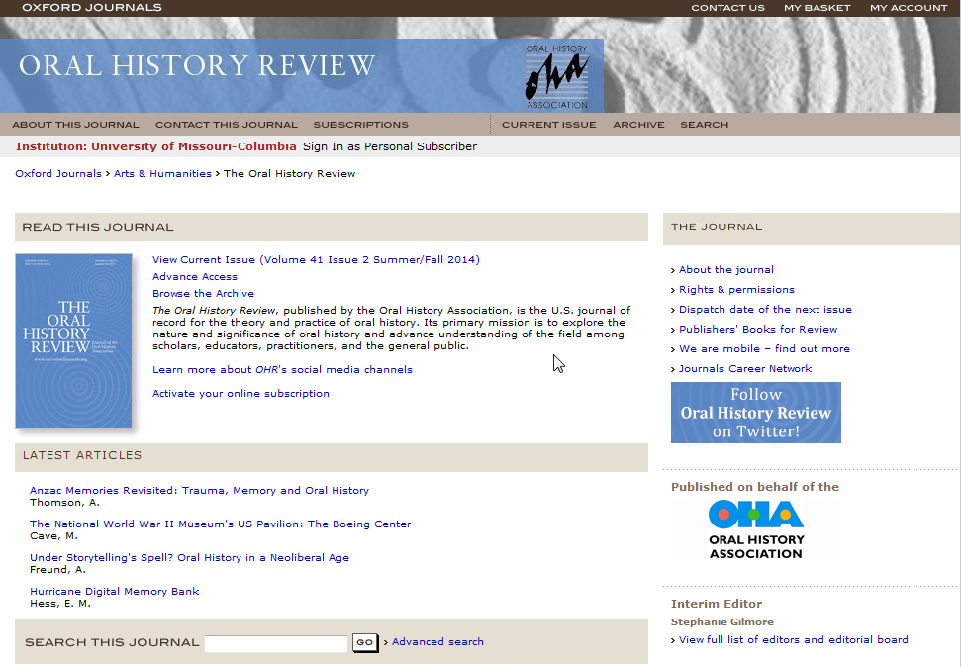
Oral History Review (Oxford)

Slide 30
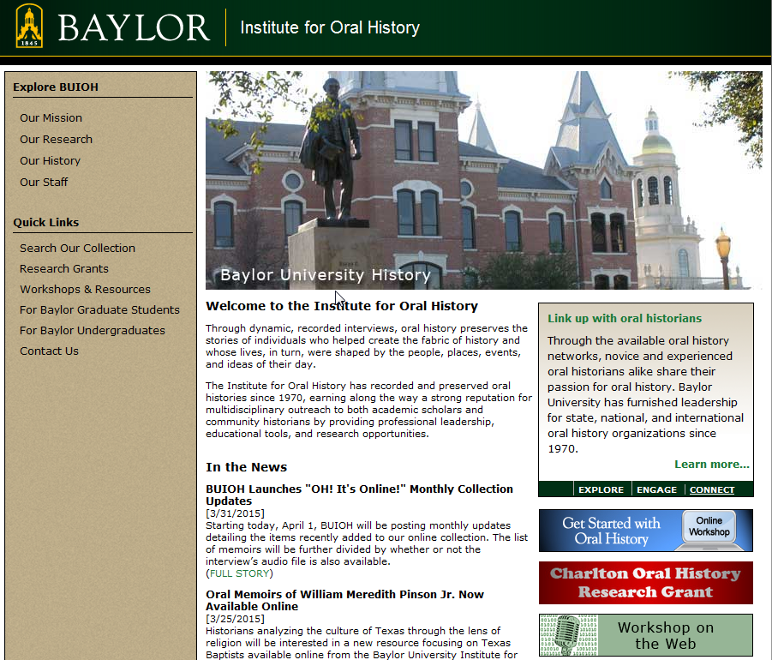
Baylor Institute for Oral History

Slide 31
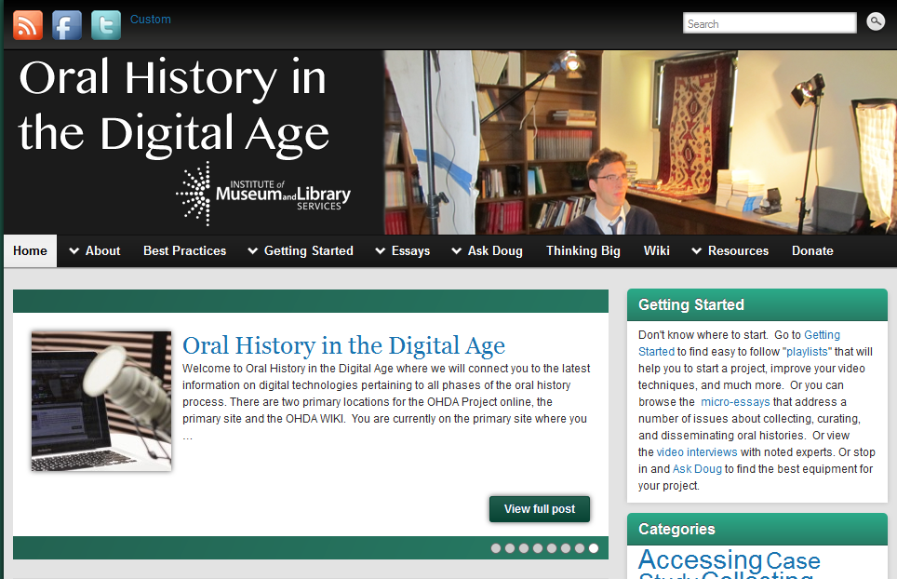
Oral History in the Digital Age (IMLS)

Slide 32
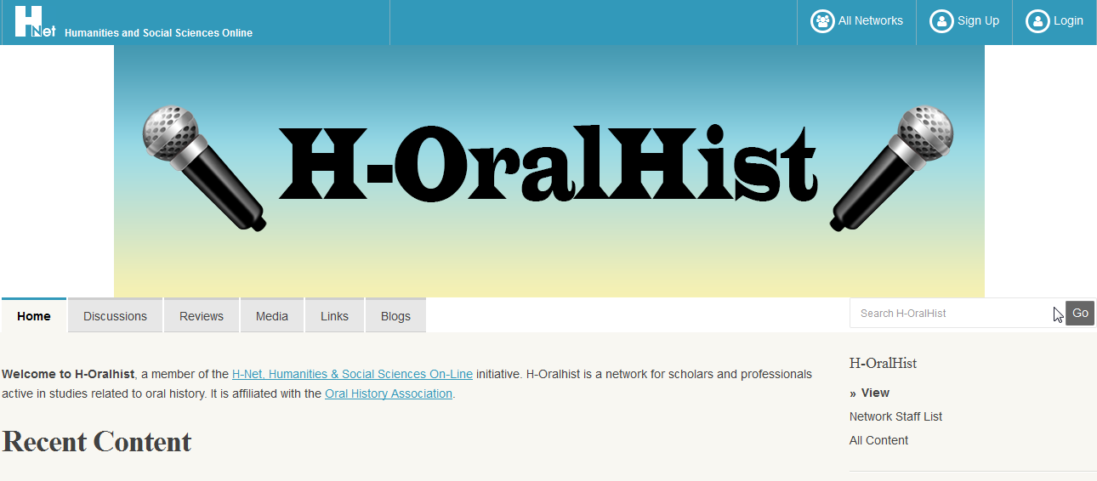
H-Oralhist

Slide 33
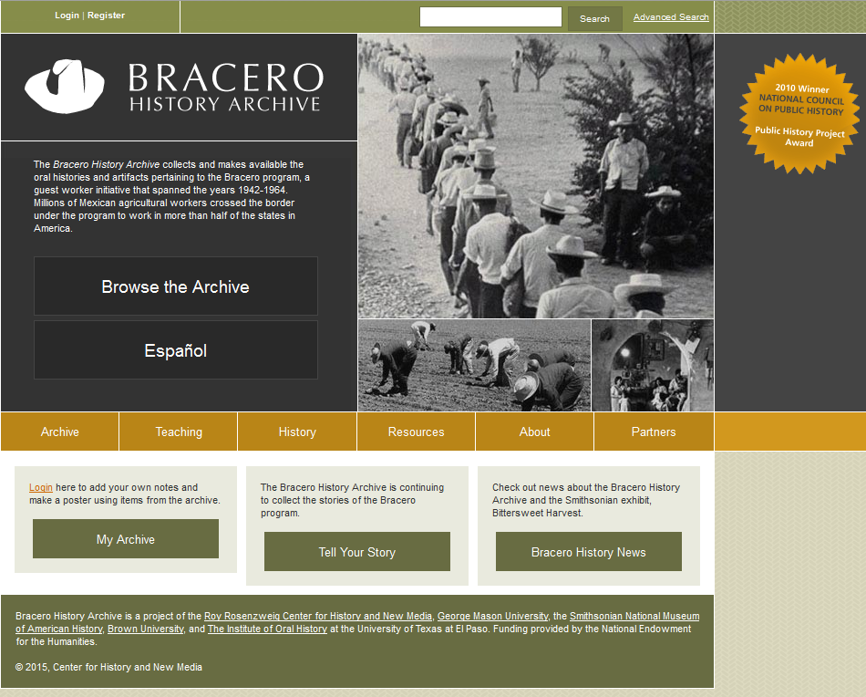
Project Examples
Bracero History Archive

Slide 34
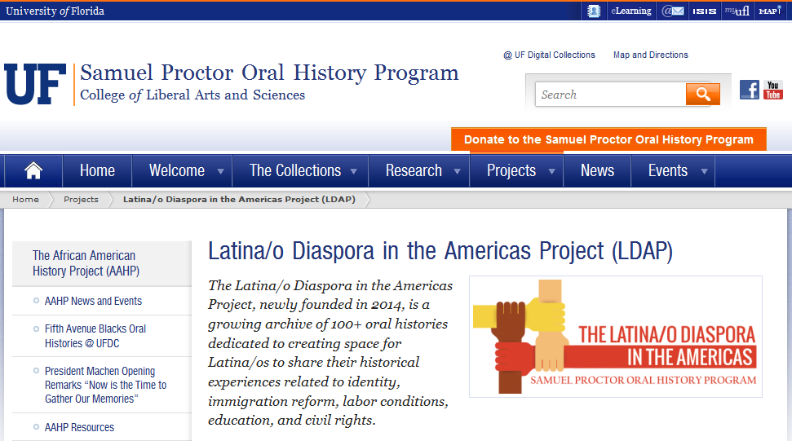
Project Examples
University of Florida

Slide 35
Technology

Slide 36
Resources (again)
Do you have money to buy your own equipment? If so, are you:
  Purchasing equipment for a library project?
  Purchasing equipment for check-out?
Do you have community groups (local radio stations, universities, museums) that might be willing to loan their equipment?

Slide 37
Finding the equipment you need
Two great online resources for deciding what equipment you’ll want:
Ask Doug, on the Oral History in the Digital Age site http://ohda.matrix.msu.edu/doug/
The Vermont Folklife Center’s Digital Audio Field Recording Equipment Guide - http://www.vermontfolklifecenter.org/archive/res_audioequip.htm

Slide 38
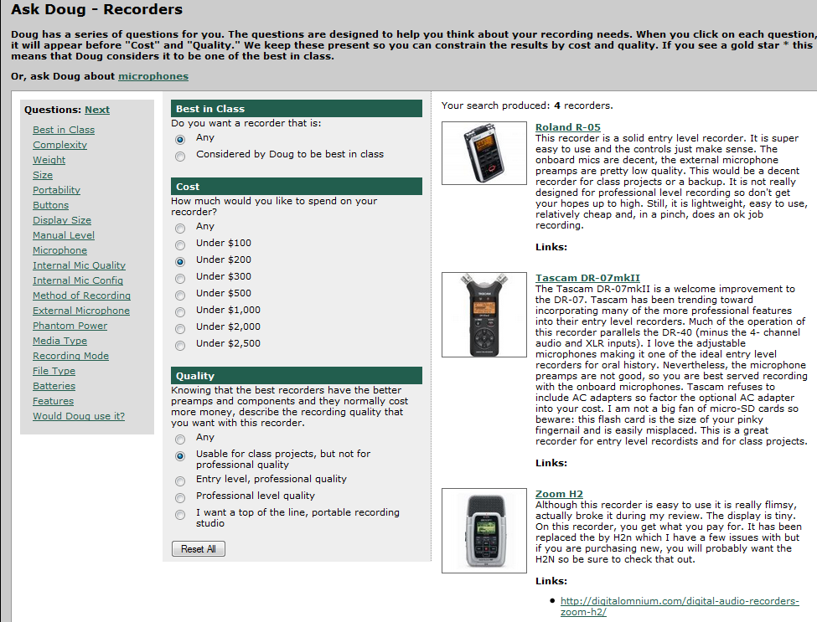
Oral History in the Digital Age

Slide 39
Finding the equipment you need
Considerations:
If you are planning to check-out equipment, get sturdier, less-expensive recorders.
Otherwise, get the best quality recorder you can afford.
Be sure that you get a recorder that produces .wav files rather than proprietary formats or compressed files (like mp3s).

Slide 40
Thank You.
Questions?

Slide 41
LA500 grantees who would like to consult with an oral historian may contact:
Kristine Navarro McElhaney
Latino Americans Outreach Advisor
knavarr5@asu.edu
Public History Program Coordinator
School of Historical, Philosophical and Religious Studies
Arizona State University

